Slide 1

Major Project Presentation
on
“Server-less Real Time Data Processing App”
Submitted To:
1. Dr. Sunil Kumar Jangir
HoD, IT
2. Mr. Naveen Kumar Kedia
Project Coordinator, IT
3. Ms. Shweta Saxena
Project Guide, IT
Presented By:
Saksham Jain (15EJCIT068)
Varun Soni (15EJCIT092)
Avani Mishra (15EJCIT015)
Pragati Bansal (15EJCIT056)
Date: 25th February 2019

Slide 2
Contents
Objective
Requirements
Project Architecture
Progress of Project
Data Base
Screenshots

Slide 3
OBJECTIVE
By processing the data in motion, real-time Big Data Processing enables us to walk in parallel with the current landscape of our Business and turn data intelligence into vital business decisions. Whether it is positive, negative or neutral, a clear picture can be visualized about the current status of the projects. The demand of Real Time Streaming Platforms is high these days. No doubt that the data being generated today every second is colossal, but what use is the data of if it is not processed to draw conclusions, trends, patterns, and outliers? Not merely the processing, but a quick processing should be done quickly so that a firm can react to the changing patterns in the business in real-time.

Slide 4
REQUIREMENTS
Kinesis Data Analytics
Amazon S3
Amazon Dynamo DB
Amazon Lambda
Amazon Athena
Amazon Data Firehose

Slide 5
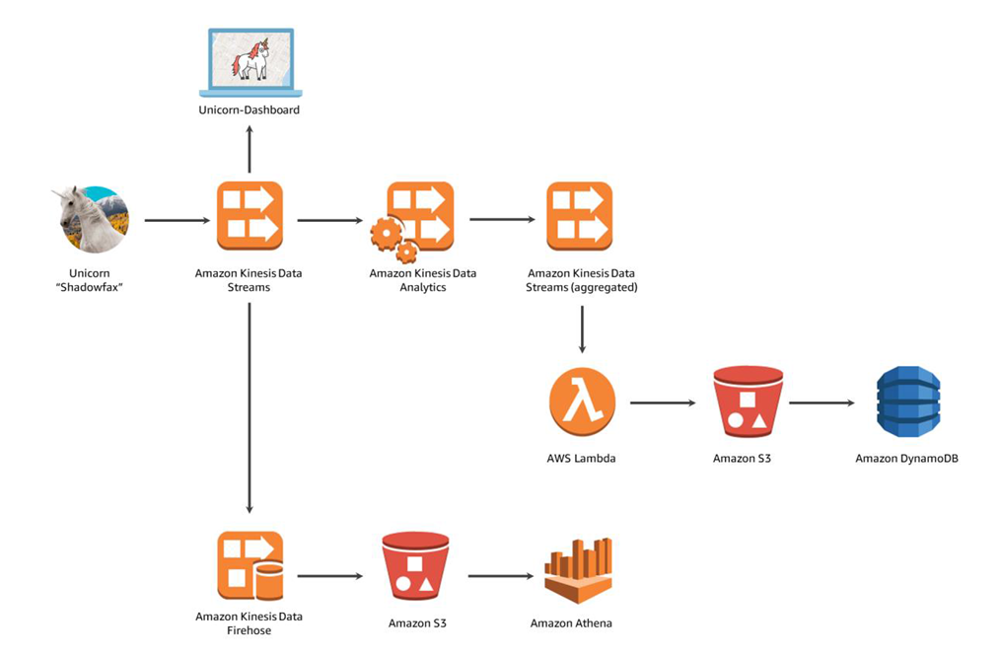
PROJECT ARCHITECTURE

Slide 6
PROGRESS OF PROJECT
We divide this Project into 4 Modules:-
1. Build a data stream : We have Create a stream in Kinesis and write to and read from the stream to track Wild Rydes unicorns on the live map. We use 2 data streams Producer and consumer which is amazon kinesis data stream.
2. Aggregate data :- In this module we will Build a Kinesis Data Analytics application to read from the stream and aggregate metrics like unicorn health and distance traveled each minute.
3. Processing Data Stream :- In this Module we use AWS Lambda to process data from the wildrydes Amazon Kinesis stream created in previous module. We create and configure a Lambda function to read from the stream and write records to an Amazon DynamoDB table as they arrive.
4. Store and query data :- In this module we use Amazon Kinesis Data Firehouse to batch the data and deliver it to Amazon S3 to archive it. Using Amazon Athena, we run ad-hoc queries against the raw data in the Amazon S3 bucket.

Slide 7
DATABASE
For Data Base, we use Amazon DynamoDB.
Used to store the data coming from streams for processing.
It is NoSQL and Dynamic in nature so it makes attributes according to data coming from Stream.

Slide 8
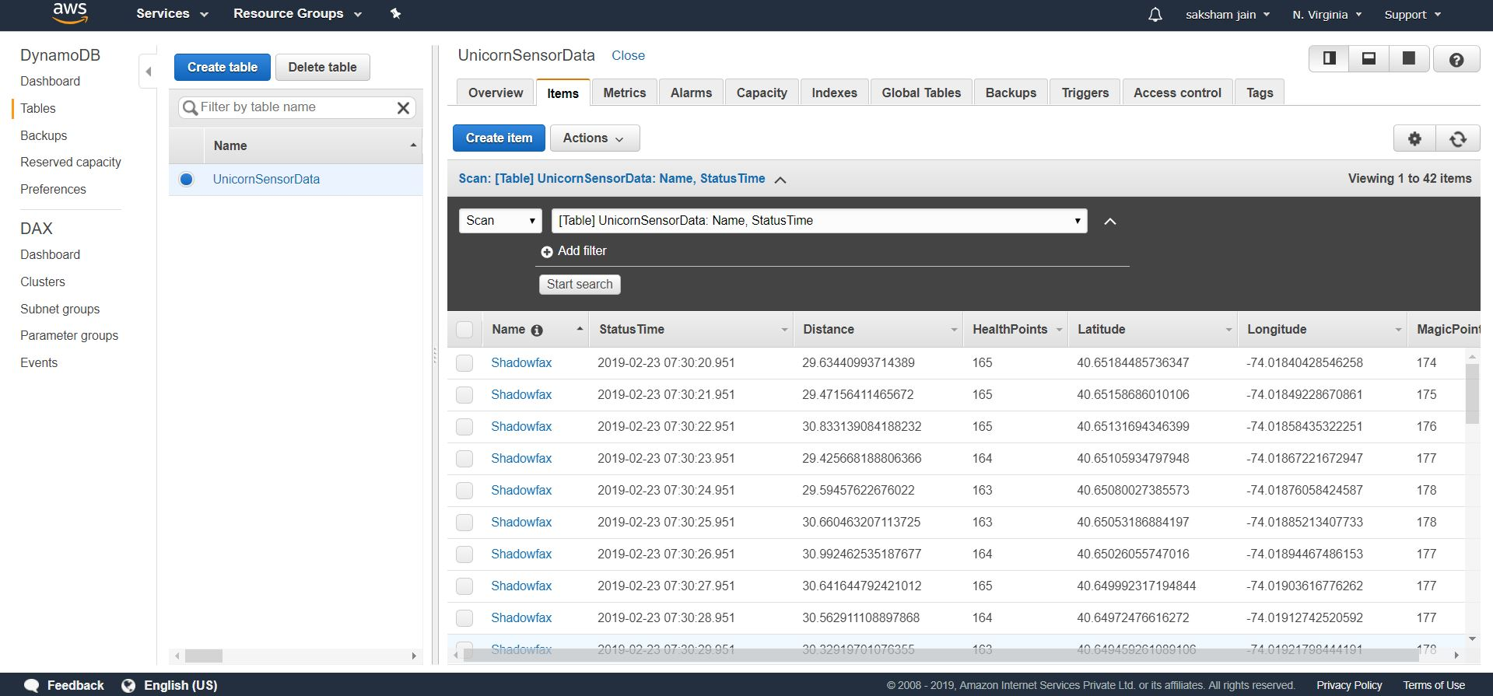
Screenshot (DynamoDB table)

Slide 9
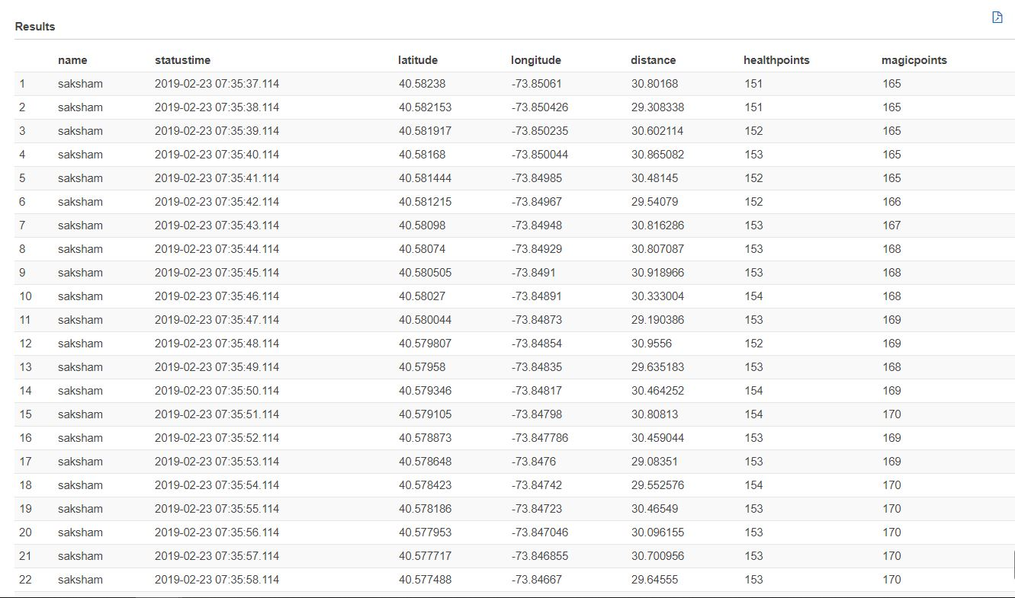
Athena Table

Slide 10
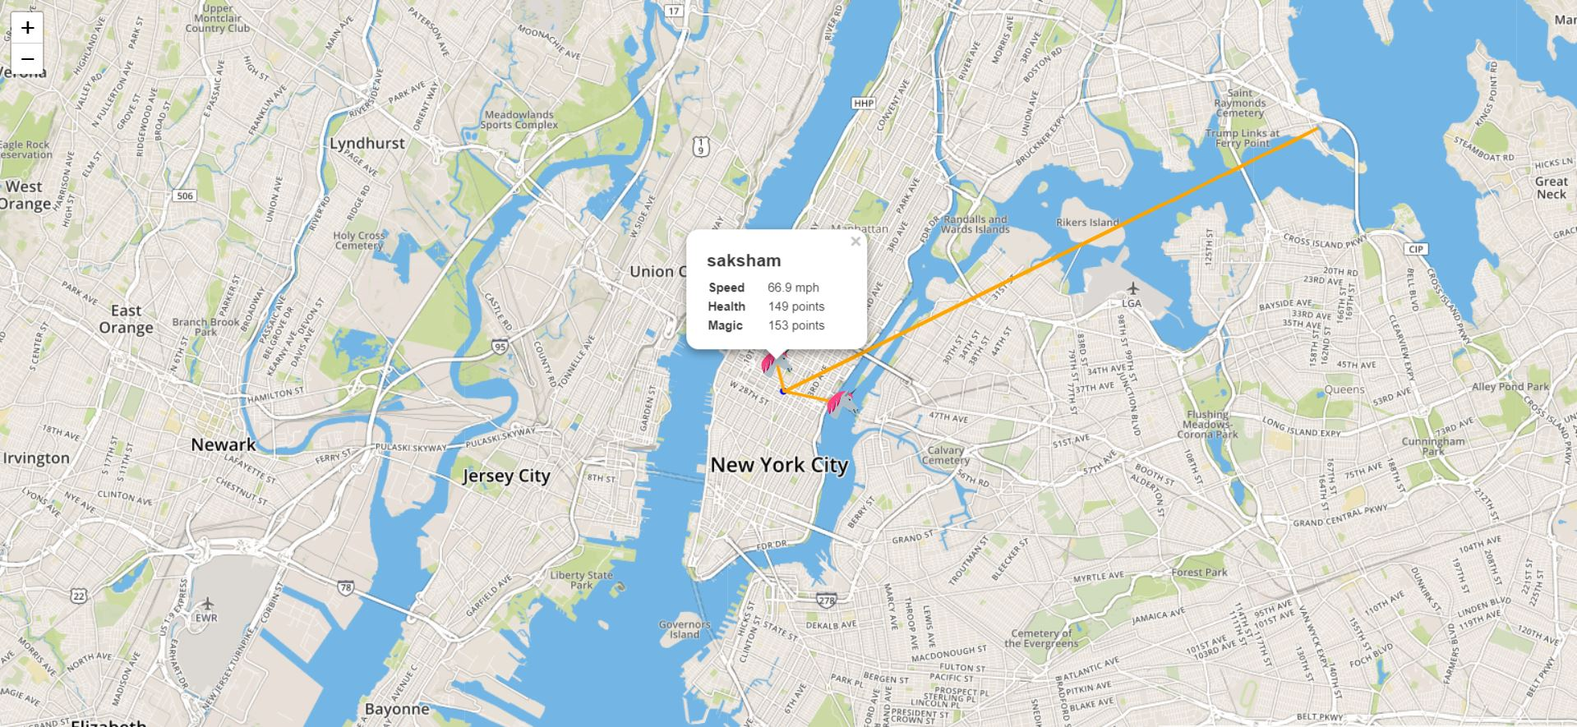
Unicorn Status

Slide 11
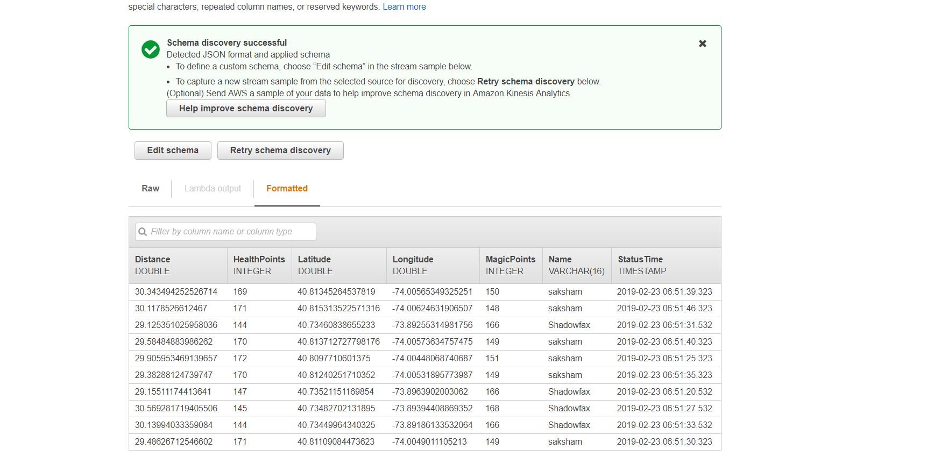
Schema of database

Slide 12
THANK YOU

